Slide 1

Supply Chain Analysis

Slide 2

Meet Our Project Contributors
Hari Prasad Rao
Pradeep C. P
Namoju Sowmya
Sindhuja Samudrala
Priyanka Yadav
Anusha C.
Shiva Yadav

Slide 3
Project Summary
The analysis covers Sales, Product, Store, and Inventory data across multiple regions and states to identify business performance trends.
The total sales value observed is $388.13M, distributed across 37 states and over 1000 unique products.
Arts & Entertainment and Electronics categories performed the best, while Mobiles showed the lowest sales figures.
The West Region, particularly California, generated the highest sales, followed by the South Region.
Among stores, Woodland store had the top sales performance, while New York store recorded the lowest.
Inventory analysis revealed overstocking in a few product families and stock shortages in high-demand items.
Purchase Method analysis showed that in-store purchases still dominate sales, though online transactions are gradually increasing.

Slide 4
KPI List Overview
TOTAL SALES
PRODUCT WISE SALES
SALES GROWTH
DAILY SALES TREND
TOP 5 STORE WISE SALES
REGION WISE SALES
INVENTORY VALUE
PROFIT PERCENTAGE
PURCHASE METHOD WISE SALES

Slide 5
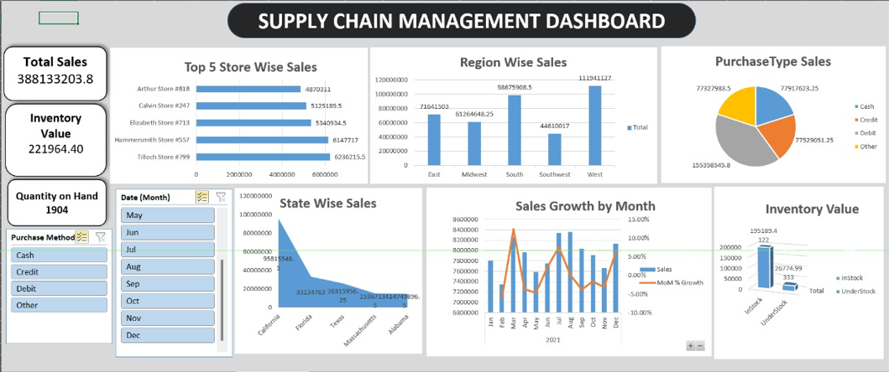
Excel Dashboard
The Excel Dashboard provides a comprehensive view of critical metrics and features essential for evaluating supply chain efficiency, enabling proactive decision-making and strategic analysis.

Slide 6
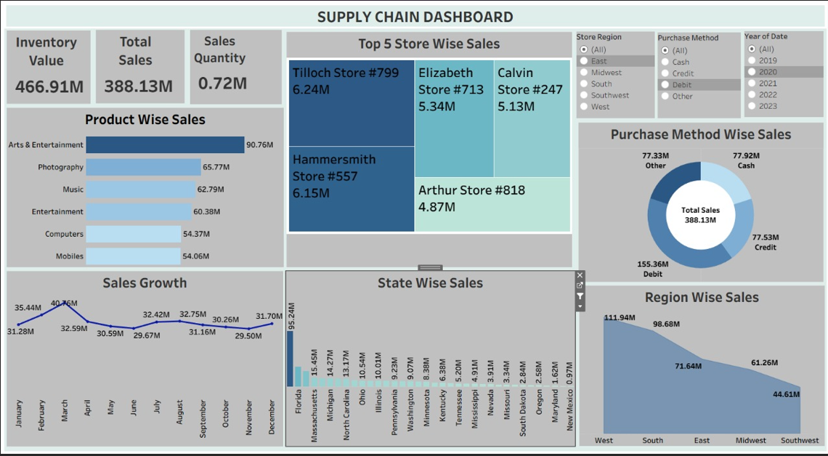
Tableau Dashboard
The Tableau Dashboard provides interactive visualizations and advanced analytics capabilities, enabling real-time data insights to drive strategic decision-making and enhance supply chain efficiency.

Slide 7
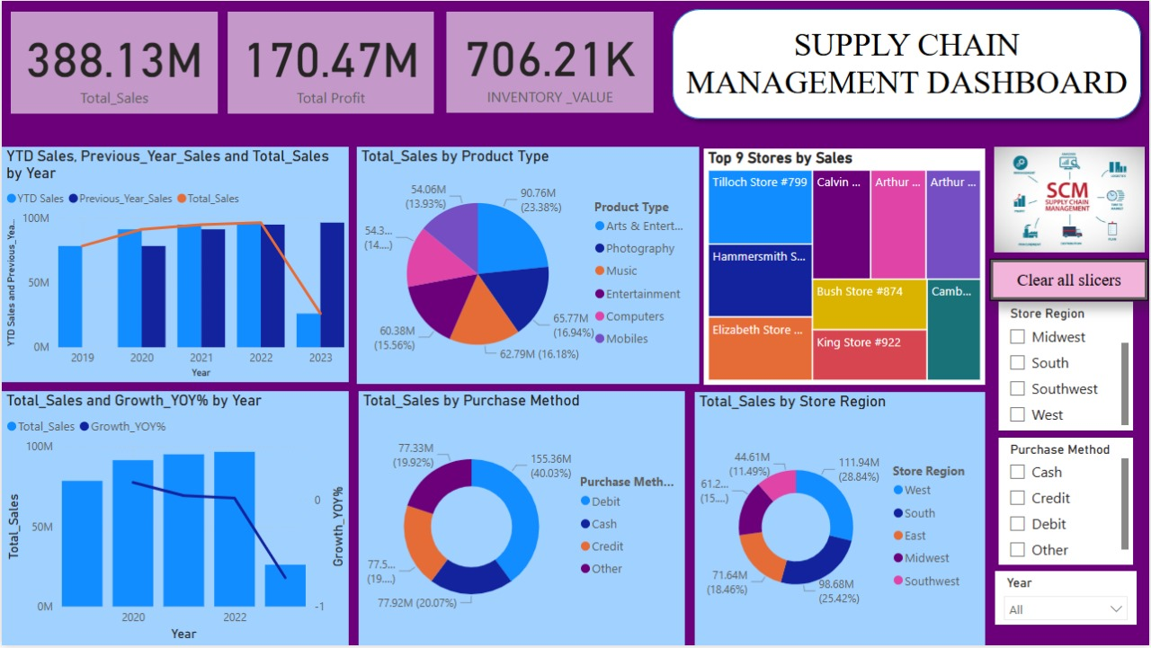
Power BI Dashboard

Slide 8
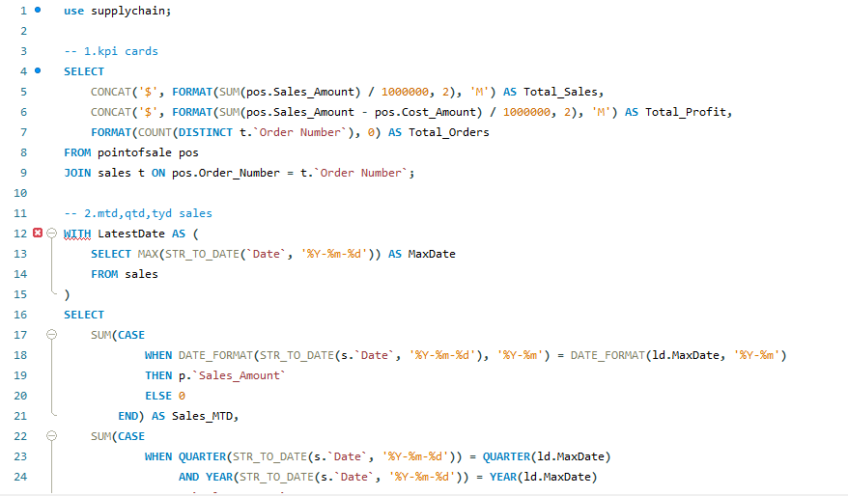
SQL Insights
KPI Calculations

Slide 9
Suggestions for Supply Chain
KPI 1. Total Sales (MTD, QTD, YTD)
Regularly monitor and compare Month-to-Date (MTD), Quarter-to-Date(QTD) and Year-to-Date(YTD) sales against business targets. These KPIs help track performance, identify seasonal trends and understand overall business growth.
KPI 2. Product-wise Sales
Analyze product-wise sales to determine which products are performing well and which are underperforming. This supports inventory planning, marketing strategy and product improvement decisions.
KPI 3. Sales Growth
Track sales growth over different time periods to measure business expansion. Comparing growth trends across months or quarter helps identify successful strategies and highlight areas needing improvement.
KPI 4. Daily Sales Trend
Monitor daily sales to react quickly to market changes and customer behavior. This helps in adjusting pricing, promotions or marketing campaigns in real time.

Slide 10
Suggestions for Supply Chain
KPI 5. State-wise Sales
Evaluate state-level sales performance to identify regional differences. This helps optimize regional marketing, distribution strategies, and resource allocation.
KPI 6. Top Store-wise Sales
Focus on top-performing stores to understand what drives their success. Best practices from high-performing locations can be applied to underperforming stores.
KPI 7. Region-wise Sales
Assess region-wise sales to understand market potential and customer demand in each region, enabling better strategic planning and targeted decision-making.
KPI 8. Inventory Value
Monitor inventory value to understand the financial impact of stock on the business. This supports better budgeting, forecasting, and capital utilization.
KPI 9. Profit %
Compare company profit margin with targets and industry benchmarks. Tracking profit trends over time helps measure financial health and identify opportunities to improve profitability.

Slide 11
Suggestions for Supply Chain
KPI 10. Total Inventory
Track total inventory levels to ensure optimal stock management. Balanced inventory prevents overstocking and stockouts, reducing holding costs and improving cash flow.
KPI 11. Purchase Method-wise Sales
Analyze sales by purchase method (online, in-store, card, cash, mobile, etc.) to understand customer preferences. This supports channel optimization and enhances customer experience.

Slide 12

Key Takeaways
Data-driven decisions can significantly enhance sales efficiency and inventory turnover.
Maintaining balanced stock levels improves customer satisfaction and cash flow stability
Regional and product-wise insights support targeted marketing and store-level strategy
Continuous KPI monitoring ensures consistent business growth and early issue detection.
The analysis demonstrates how data visualization and analytics tools (Excel, Power Bl, Tableau, SQL)help in making strategic supply chain decisions.

Slide 13

Thank You

